Slide 1

The Effect of Histamine on the Retina
Nate Stanko, Tiriac Lab

Slide 2
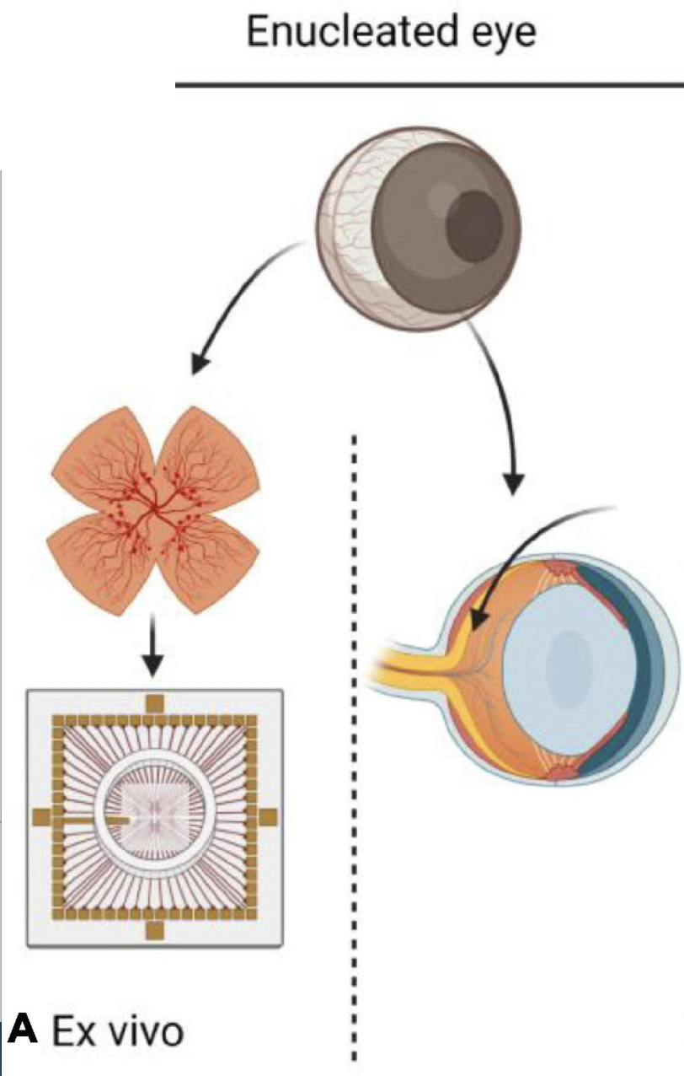
MEA Dataset Introduction
- The retina is most posterior tissue layer within the eye
- The data was collected with instrument called a multi-electrode array (MEA)
- An MEA is essentially a plane of electrodes that can either excite neural tissue or detect neural tissue activity
- Dataset consists of neuronal activity found within a retina over a given amount of time
- Experimental Question: How does the addition of histamine influence the electrical activity found in the retina?

Slide 3
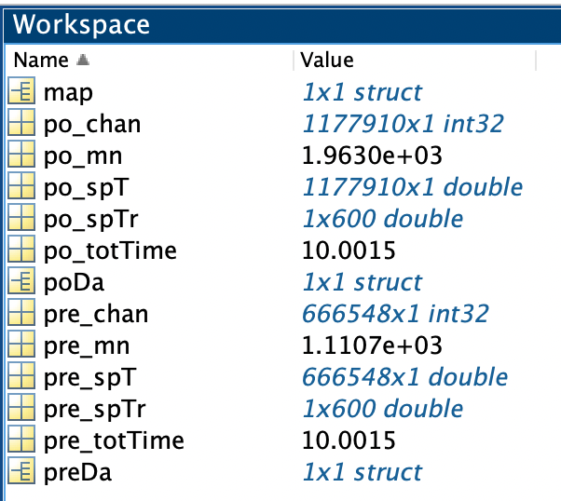
MEA Dataset Description
- Matlab is both the software used in my lab and the software used for data analysis
- Selected data represents only ~10 minutes of a single MEA recording (red)
- Raw data depicts the time at which some amount of activity occurs (blue)
- Raw data was converted to the amount of activity that occurs each second (pink)
- Processed data is how much activity occurs in the retina during each second, for 10 minutes, resulting in 600 data points

Slide 4
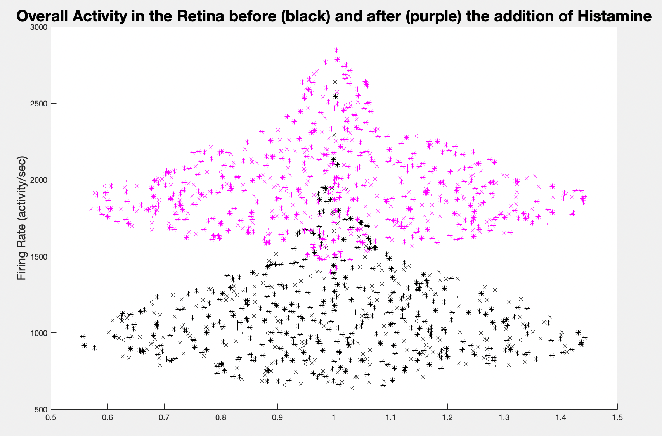
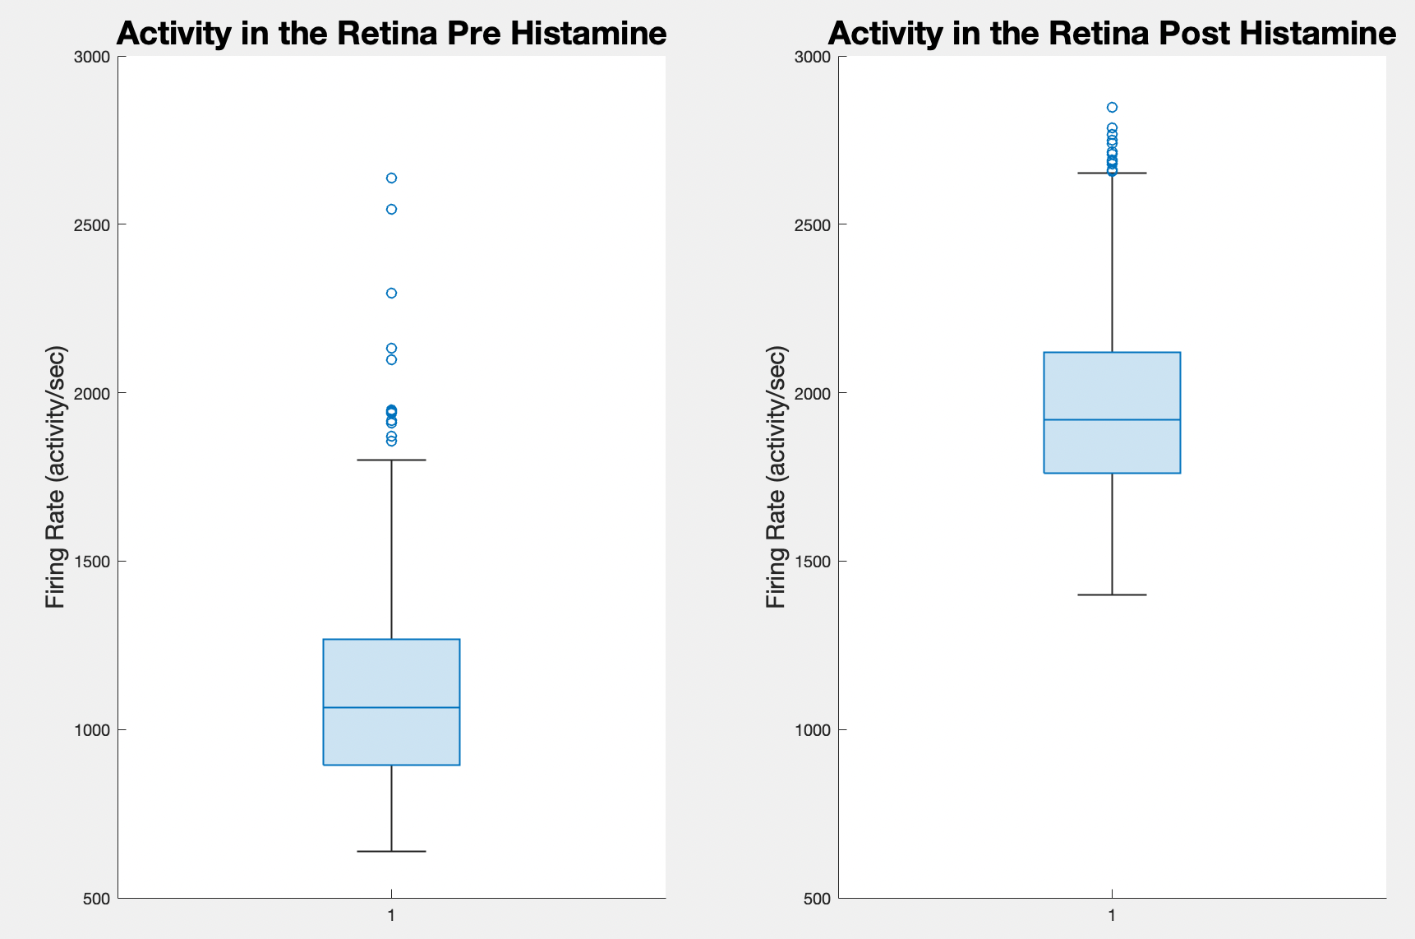
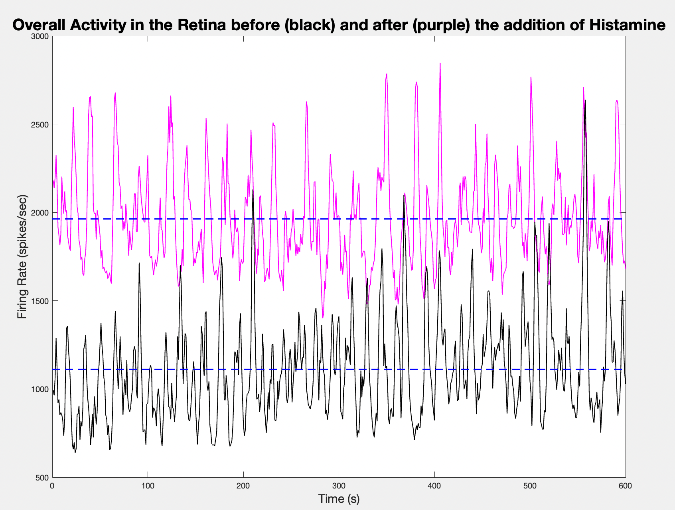
Activity in the Retina before and after Histamine Addition

Slide 5
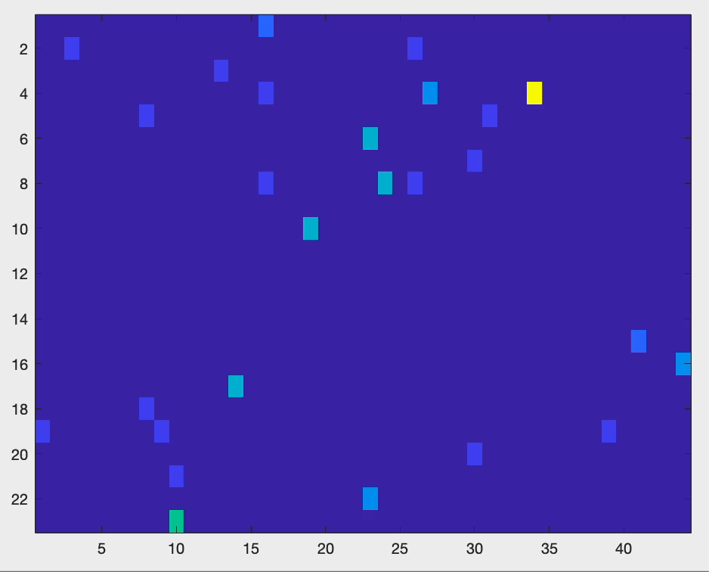
Multi-Electrode Array Activity Heatmap

Slide 6
Takeaway
Addition of histamine to the retina is correlated with increased activity within the retina

